Slide 1
Guess who’s fault
"Every act of creation is first an act of destruction”
- Pablo Picasso

Slide 2
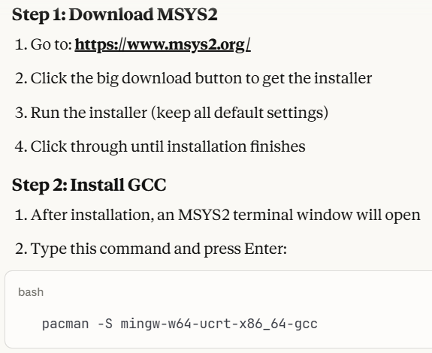
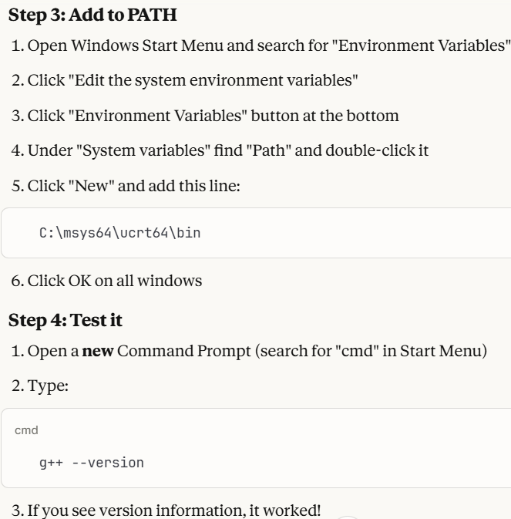
Setup c++
Windows

Slide 3
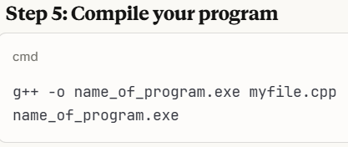
Setup c++
Windows

Slide 4
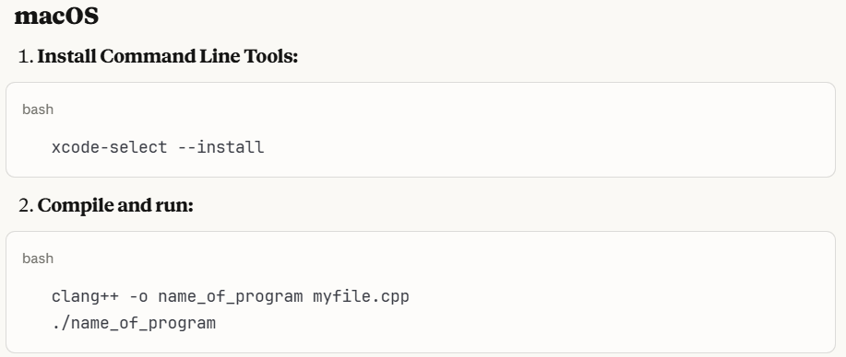
Setup c++
Mac

Slide 5
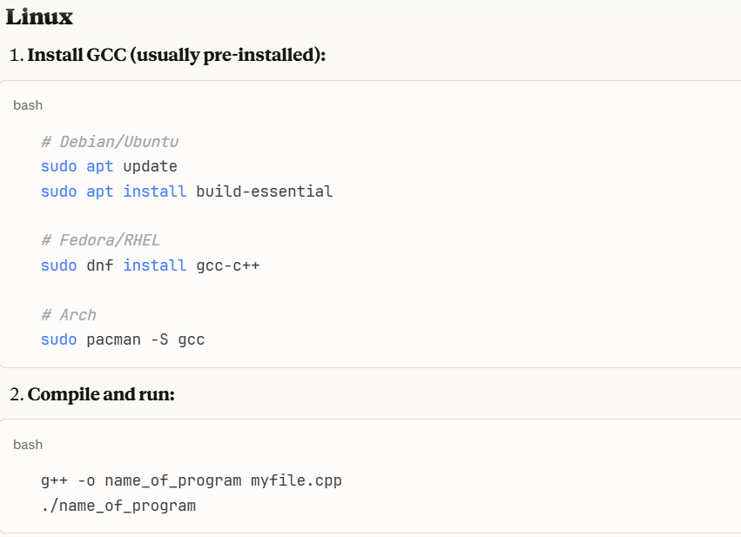
Setup c++
Linux

Slide 6
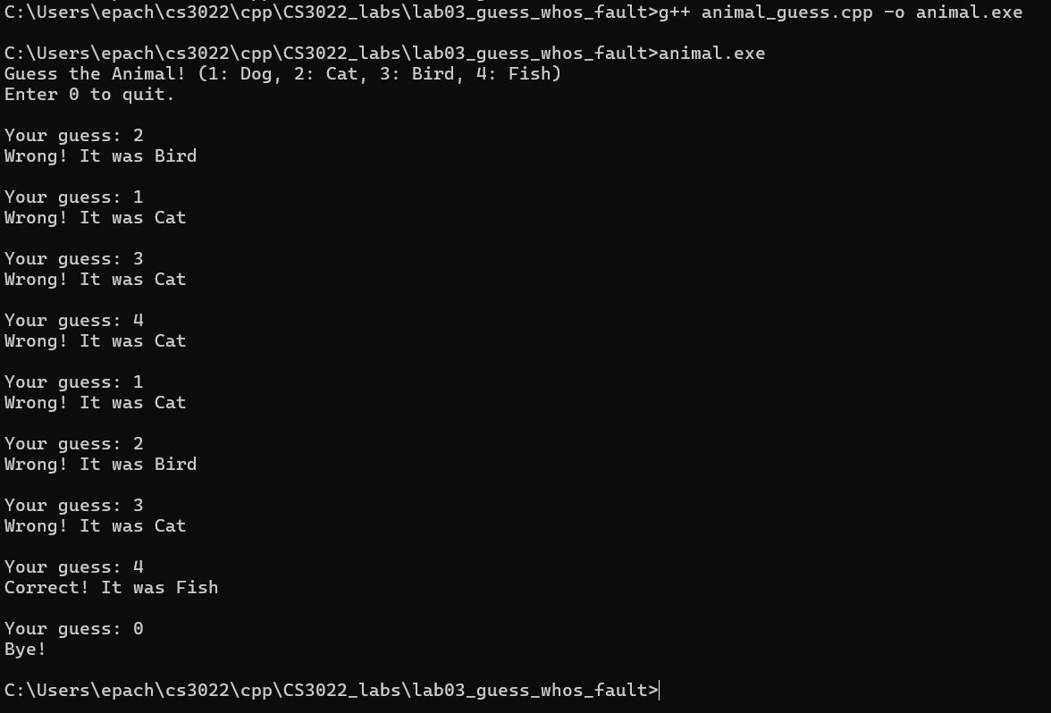
Animal guessing game

Slide 7
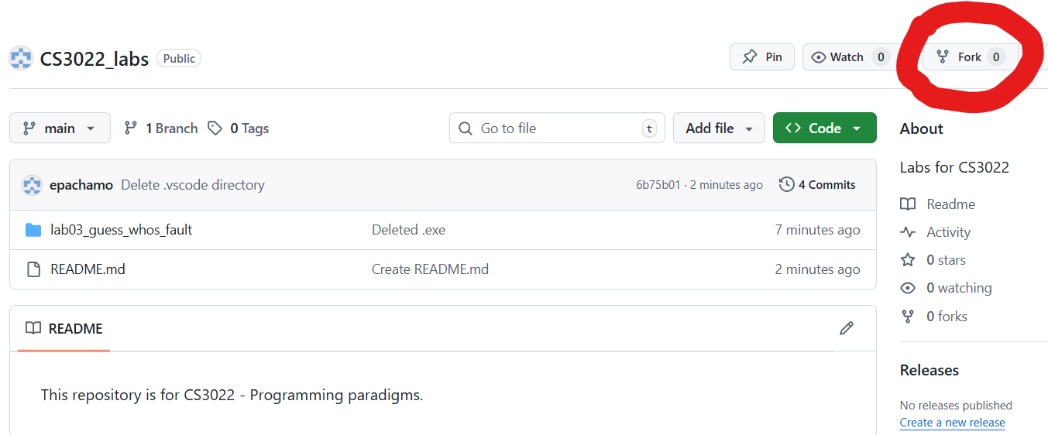
Working with GIT
* Fork C++ code for this project at:
https://github.com/epachamo/CS3022_labs/tree/main
* Do a git clone from YOUR repository to your local machine.
* Do the lab.
* Commit your changes
* Do a pull request
* Merge your changes to YOUR repository

Slide 8
Notable code sections
enum’s in C++ are equivalent to numbers. By default it starts at 0 and increments by 1. Here it starts at 1, and increments to 4.
DOG = 1
CAT = 2
BIRD = 3
FISH = 4
Notes:
enum’s in C++ are equivalent to numbers. By default it starts at 0 and increments by 1. Here it starts at 1, and increments to 4.
DOG = 1
CAT = 2
BIRD = 3
FISH = 4

Slide 9
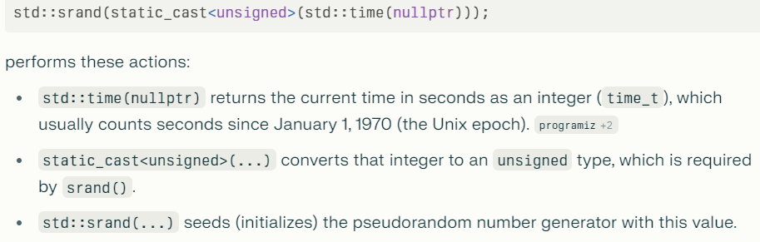
Notable code sections
Notes:
enum’s in C++ are equivalent to numbers. By default it starts at 0 and increments by 1. Here it starts at 1, and increments to 4.
DOG = 1
CAT = 2
BIRD = 3
FISH = 4

Slide 10
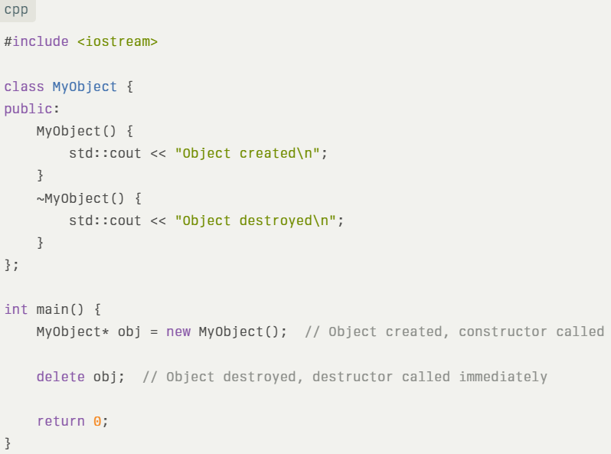
Creation / destruction
What is created on the heap, must be destroyed. C++ is not a managed language. There is no automated garbage collection.

Slide 11
There are subtle errors in this code
* I injected three errors into this code. Find the three errors and fix them.
* Add validation code, to check if the user enters something other than 0, 1, 2, 3 or 4.
* Answer the questions.

Slide 12
questions
#0 – What are the three errors?
#1 – When mysteryAnimal is declared, the next instruction prints out: “The animal is initialized to: …” It is never initialized to a variable. Why does this not crash?? What is it being initialized to??
#2 – Why is your program crashing on this line: “std::cout << "The animal should initally be nothing:…”?
#3 – Run the program for 3 different guesses. On each guess, print out:
- The address of the mysteryAnimal pointer
- The address where the pointer is pointing
- The value located at the address where the pointer is pointing.
- Draw a picture diagraming each of these memory locations with their values.
- Is the stack growing from the bottom (0x0000….) or the top (0xFFFFF…) of memory?
#4 - Relative to the stack and heap, where is the staticWelcomeMessage located? What is its address? Add it to the diagram.

Slide 13
deliverables
* e-mail richard.thompson@nps.edu
* A link to your github repository with the fixed code.
* Answers to the questions (including the diagram).

